Slide 1
Module 14: Network Automation
Enterprise Networking, Security, and Automation v7.0
(ENSA)
Notes:
Cisco Networking Academy Program
Enterprise Networking, Security, and Automationv7.0 (ENSA)
Module 14: Network Automation

Slide 2
14.1 Automation Overview
Notes:
14 - Network Automation
14.1 - Automation Overview

Slide 3
Automation Overview The Increase in Automation
These are some of the benefits of automation:
Machines can work 24 hours a day without breaks, which results in greater output.
Machines provide a more uniform product.
Automation allows the collection of vast amounts of data that can be quickly analyzed to provide information which can help guide an event or process.
Robots are used in dangerous conditions such as mining, firefighting, and cleaning up industrial accidents. This reduces the risk to humans.
Under certain circumstances, smart devices can alter their behavior to reduce energy usage, make a medical diagnosis, and improve automobile driving safety.
Notes:
14 - Network Automation
14.1 - Automation Overview
14.1.2 - The Increase in Automation

Slide 4
Automation Overview Thinking Devices
Many devices now incorporate smart technology to help to govern their behavior. This can be as simple as a smart appliance lowering its power consumption during periods of peak demand or as complex as a self-driving car.
Whenever a device takes a course of action based on an outside piece of information, then that device is referred to as a smart device. Many devices that we interact with now have the word smart in their names. This indicates that the device has the ability to alter its behavior depending on its environment.
In order for devices to “think”, they need to be programmed using network automation tools.
Notes:
14 - Network Automation
14.1 - Automation Overview
14.1.3 - Thinking Devices
14.1.4 - Check Your Understanding - Benefits of Automation

Slide 5
14.2 Data Formats
Notes:
14 - Network Automation
14.2 - Data Formats

Slide 6
Data Formats The Data Formats Concept
Data formats are simply a way to store and exchange data in a structured format. One such format is called Hypertext Markup Language (HTML). HTML is a standard markup language for describing the structure of web pages.
These are some common data formats that are used in many applications including network automation and programmability:
JavaScript Object Notation (JSON)
eXtensible Markup Language (XML)
YAML Ain’t Markup Language (YAML)
The data format that is selected will depend on the format that is used by the application, tool, or script that you are using. Many systems will be able to support more than one data format, which allows the user to choose their preferred one.
Notes:
14 - Network Automation
14.2 - Data Formats
14.2.2 - The Data Formats Concept

Slide 7
Data Formats Data Format Rules
Data formats have rules and structure similar to what we have with programming and written languages. Each data format will have specific characteristics:
Syntax, which includes the types of brackets used, such as [ ], ( ), { }, the use of white space, or indentation, quotes, commas, and more.
How objects are represented, such as characters, strings, lists, and arrays.
How key/value pairs are represented. The key is usually on the left side and it identifies or describes the data. The value on the right is the data itself and can be a character, string, number, list or another type of data.
Notes:
14 - Network Automation
14.2 - Data Formats
14.2.3 - Data Format Rules

Slide 8
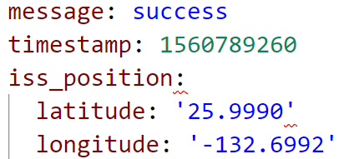
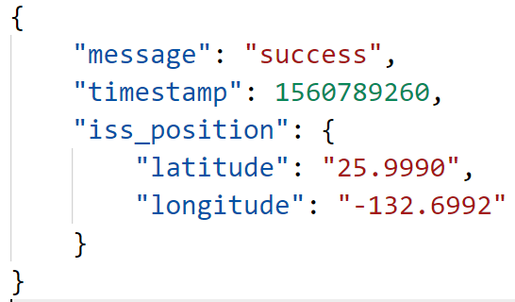
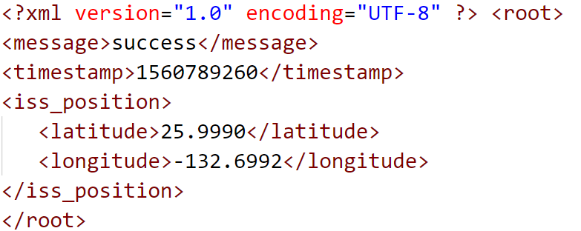
Data Formats Compare Data Formats
YAML Format
JSON Format
XML Format
Notes:
14 - Network Automation
14.2 - Data Formats
14.2.4 - Compare Data Formats

Slide 9
Data Formats JSON Data Format
JSON is a human readable data format used by applications for storing, transferring and reading data. JSON is a very popular format used by web services and APIs to provide public data. This is because it is easy to parse and can be used with most modern programming languages, including Python.
Notes:
14 - Network Automation
14.2 - Data Formats
14.2.5 - JSON Data Format

Slide 10
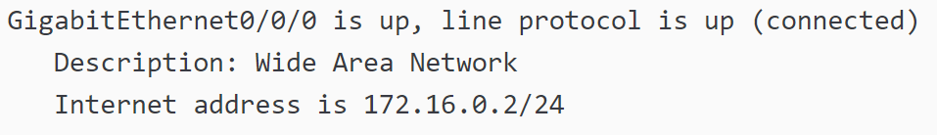
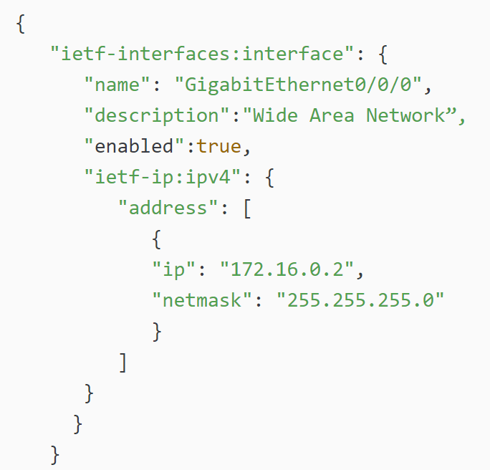
Data Formats JSON Data Format (Cont.)
Compare the IOS output above to the output in JSON format. Notice that each object (each key/value pair) is a different piece of data about the interface including its name, a description, and whether the interface is enabled.
Notes:
14 - Network Automation
14.2 - Data Formats
14.2.5 - JSON Data Format

Slide 11
Data Formats JSON Syntax Rules
These are some of the characteristics of JSON:
It uses a hierarchical structure and contains nested values.
It uses braces { } to hold objects and square brackets [ ] hold arrays.
Its data is written as key/value pairs.
With JSON, the data known as an object is one or more key/value pairs enclosed in braces { }. The syntax for a JSON object includes:
Keys must be strings within double quotation marks " ".
Values must be a valid JSON data type (string, number, array, Boolean, null, or another object).
Keys and values are separated by a colon.
Multiple key/value pairs within an object are separated by commas.
White space is not significant.
Notes:
14 - Network Automation
14.2 - Data Formats
14.2.6 - JSON Syntax Rules

Slide 12
Data Formats JSON Syntax Rules (Cont.)
At times a key may contain more than one value. This is known as an array. An array in JSON is an ordered list of values. Characteristics of arrays in JSON include:
The key followed by a colon and a list of values enclosed in square brackets [ ].
The array is an ordered list of values.
The array can contain multiple value types including a string, number, Boolean, object or another array inside the array.
Each value in the array is separated by a comma.
Notes:
14 - Network Automation
14.2 - Data Formats
14.2.6 - JSON Syntax Rules (Cont.)

Slide 13
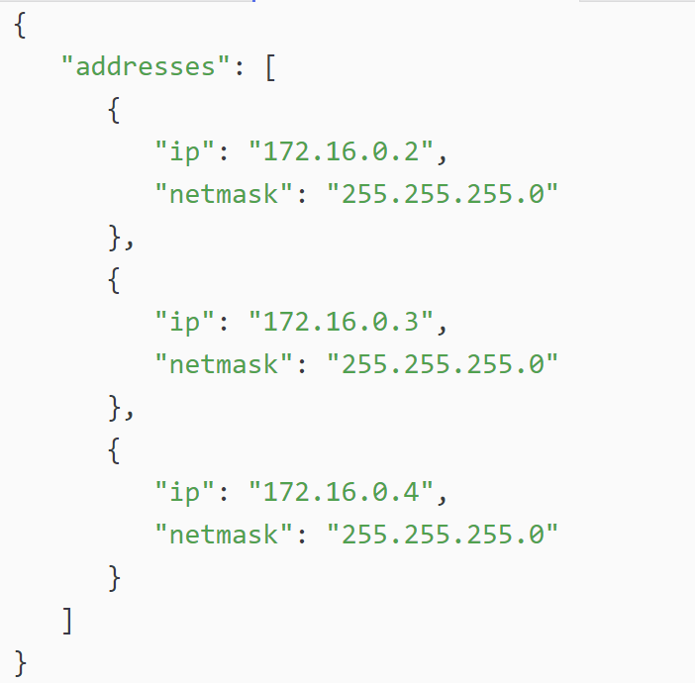
Data Formats JSON Syntax Rules (Cont.)
For example, a list of IPv4 addresses might look like the following output. The key is “addresses”. Each item in the list is a separate object, separated by braces { }. The objects are two key/value pairs: an IPv4 address (“ip”) and a subnet mask (“netmask”) separated by a comma. The array of objects in the list is also separated by a comma following the closing brace for each object.
Notes:
14 - Network Automation
14.2 - Data Formats
14.2.6 - JSON Syntax Rules (Cont.)

Slide 14
Data Formats YAML Data Format
YAML is another type of human readable data format used by applications for storing, transferring, and reading data. Some of the characteristic of YAML include:
It is like JSON and is considered a superset of JSON.
It has a minimalist format making it easy to both read and write.
It uses indentation to define its structure, without the use of brackets or commas.
Notes:
14 - Network Automation
14.2 - Data Formats
14.2.7 - YAML Data Format

Slide 15
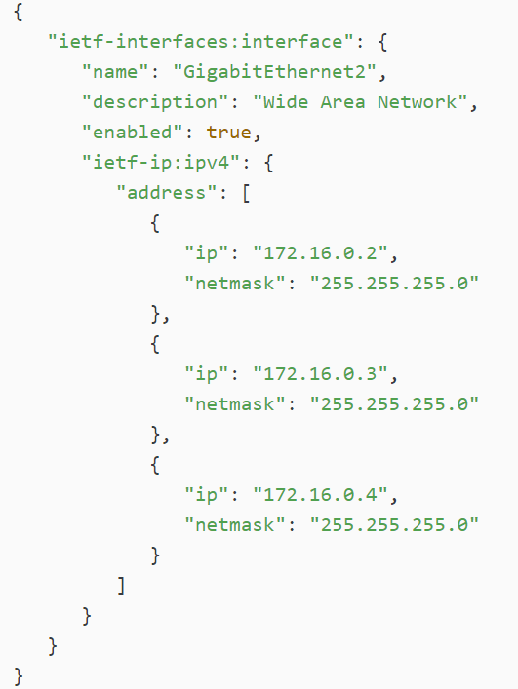
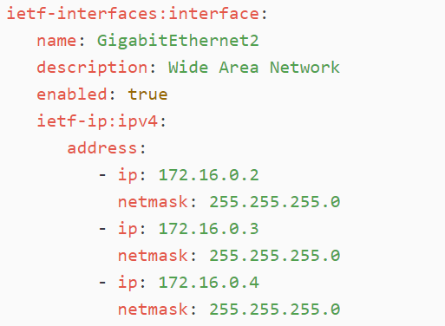
Data Formats YAML Data Format (Cont.)
IOS output in JSON is to the left. The same data in YAML format is below. It is easier to read.
Similar to JSON, a YAML object is one or more key value pairs. Key value pairs are separated by a colon without the use of quotation marks. In YAML, a hyphen is used to separate each element in a list.
Notes:
14 - Network Automation
14.2 - Data Formats
14.2.7 - YAML Data Format (Cont.)

Slide 16
Data Formats XML Data Format
XML is one more type of human readable data format used to store, transfer, and read data by applications. Some of the characteristics of XML include:
It is like HTML , which is the standardized markup language for creating web pages and web applications.
It is self-descriptive. It encloses data within a related set of tags: <tag>data</tag>
Unlike HTML, XML uses no predefined tags or document structure.
XML objects are one or more key/value pairs, with the beginning tag used as the name of the key: <key>value</key>
Notes:
14 - Network Automation
14.2 - Data Formats
14.2.8 - XML Data Format

Slide 17
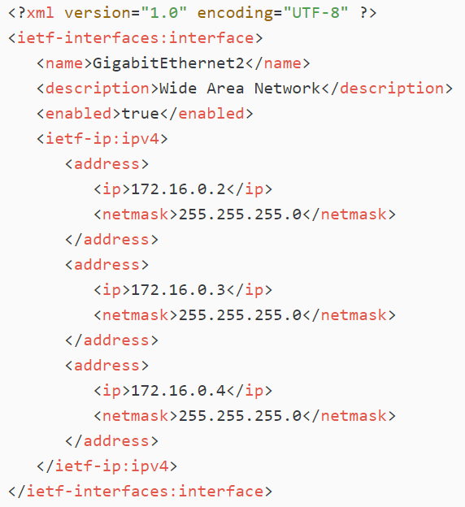
Data Formats XML Data Format (Cont.)
The output shows the same data for GigabitEthernet2 formatted as an XML data structure. Notice how the values are enclosed within the object tags. In this example, each key/value pair is on a separate line and some lines are indented. This is not required but is done for readability. The list uses repeated instances of <tag></tag> for each element in the list. The elements within these repeated instances represent one or more key/value pairs.
Notes:
14 - Network Automation
14.2 - Data Formats
14.2.8 - XML Data Format (Cont.)
14.2.9 - Check Your Understanding - Data Formats

Slide 18
14.3 APIs
Notes:
14 - Network Automation
14.3 - APIs

Slide 19
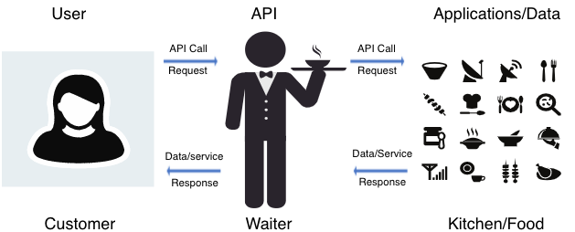
APIs The API Concept
An API is software that allows other applications to access its data or services. It is a set of rules describing how one application can interact with another, and the instructions to allow the interaction to occur. The user sends an API request to a server asking for specific information and receives an API response in return from the server along with the requested information.
An API is similar to a waiter in a restaurant, as shown in the following figure.
Notes:
14 - Network Automation
14.3 - APIs
14.3.2 - The API Concept

Slide 20
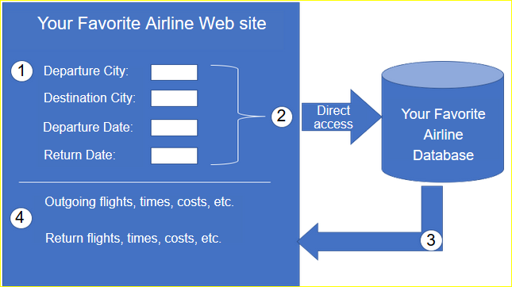
APIs An API Example
To really understand how APIs can be used to provide data and services, we will look at two options for booking airline reservations. The first option uses the web site of a specific airline. Using the airline’s web site, the user enters the information to make a reservation request. The web site interacts directly with the airline’s own database and provides the user with information matching the user’s request.
Notes:
14 - Network Automation
14.3 - APIs
14.3.3 - An API Example

Slide 21
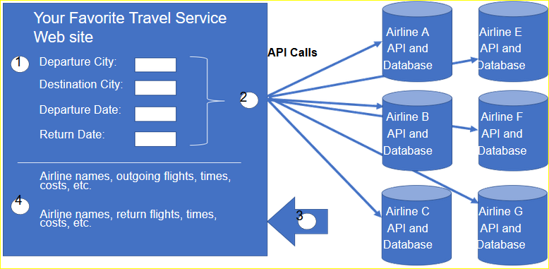
APIs An API Example (Cont.)
A travel site can access this same information, not only from a specific airline but a variety of airlines. In this case, the user enters in similar reservation information. The travel service web site interacts with the various airline databases using APIs provided by each airline. The travel service uses each airline API to request information from that specific airline, and then it displays the information from all the airlines on the its web page. The API acts as a kind of messenger between the requesting application and the application on the server that provides the data or service. The message from the requesting application to the server where the data resides is known as an API call.
Notes:
14 - Network Automation
14.3 - APIs
14.3.3 - An API Example

Slide 22
APIs Open, Internal, and Partner APIs
An important consideration when developing an API is the distinction between open, internal, and partner APIs:
Open APIs or Public APIs - These APIs are publicly available and can be used with no restrictions. Because these APIs are public, many API providers require the user to get a free key, or token, prior to using the API. This is to help control the number of API requests they receive and process.
Internal or Private APIs - These are APIs that are used by an organization or company to access data and services for internal use only. An example of an internal API is allowing authorized salespeople access to internal sales data on their mobile devices.
Partner APIs - These are APIs that are used between a company and its business partners or contractors to facilitate business between them. The business partner must have a license or other form of permission to use the API. A travel service using an airline’s API is an example of a partner API.
Notes:
14 - Network Automation
14.3 - APIs
14.3.4 - Open, Internal, and Partner APIs

Slide 23
APIs Types of Web Service APIs
A web service is a service that is available over the internet, using the World Wide Web. There are four types of web service APIs:
Simple Object Access Protocol (SOAP)
Representational State Transfer (REST)
eXtensible Markup Language-Remote Procedure Call (XML-RPC)
JavaScript Object Notation-Remote Procedure Call (JSON-RPC)
Characteristic | SOAP | REST | XML-RPC | JSON-RPC
Data Format | XML | JSON, XML, YAML, and others | XML | JSON
First released | 1998 | 2000 | 1998 | 2005
Strengths | Well-established | Flexible formatting and most widely used | Well-established, simplicity | Simplicity
Notes:
14 - Network Automation
14.3 - APIs
14.3.5 - Types of Web Service APIs
14.3.6 - Check Your Understanding - APIs

Slide 24
14.4 REST
Notes:
14 - Network Automation
14.4 - REST

Slide 25
Software-Defined Networking REST and RESTful API
Web browsers use HTTP or HTTPS to request (GET) a web page. If successfully requested (HTTP status code 200), web servers respond to GET requests with an HTML coded web page.
Simply stated, a REST API is an API that works on top of the HTTP protocol. It defines a set of functions developers can use to perform requests and receive responses via HTTP protocol such as GET and POST.
Conforming to the constraints of the REST architecture is generally referred to as being “RESTful”. An API can be considered “RESTful” if it has the following features:
Client-Server - The client handles the front end and the server handles the back end. Either can be replaced independently of the other.
Stateless - No client data is stored on the server between requests. The session state is stored on the client.
Cacheable - Clients can cache responses to improve performance.
Notes:
14 - Network Automation
14.4 - REST
14.4.2 - REST and RESTful API

Slide 26
Software-Defined Networking RESTful Implementation
A RESTful web service is implemented using HTTP. It is a collection of resources with four defined aspects:
The base Uniform Resource Identifier (URI) for the web service, such as http://example.com/resources.
The data format supported by the web service. This is often JSON, YAML, or XML but could be any other data format that is a valid hypertext standard.
The set of operations supported by the web service using HTTP methods.
The API must be hypertext driven.
RESTful APIs use common HTTP methods including POST, GET, PUT, PATCH and DELETE. As shown in the following table, these correspond to RESTful operations: Create, Read, Update, and Delete (or CRUD).
HTTP Method | RESTful Operation
POST | Create
GET | Read
PUT/PATCH | Update
DELETE | Delete
Notes:
14 - Network Automation
14.4 - REST
14.4.3 - RESTful Implementation

Slide 27
Software-Defined Networking URI, URN, and URL
Web resources and web services such as RESTful APIs are identified using a URI. A URI is a string of characters that identifies a specific network resource. A URI has two specializations:
Uniform Resource Name (URN) - identifies only the namespace of the resource (web page, document, image, etc.) without reference to the protocol.
Uniform Resource Locator (URL) - defines the network location of a specific resource. HTTP or HTTPS URLs are typically used with web browsers. Protocols such as FTP, SFTP, SSH, and others can use a URL. A URL using SFTP might look like: sftp://sftp.example.com.
These are the parts of the URI https://www.example.com/author/book.html#page155 :
Protocol/scheme – HTTPS or other protocols such as FTP, SFTP, mailto, and NNTP
Hostname - www.example.com
Path and file name - /author/book.html
Fragment - #page155
Notes:
14 - Network Automation
14.4 - REST
14.4.4 - URI, URN, and URL

Slide 28
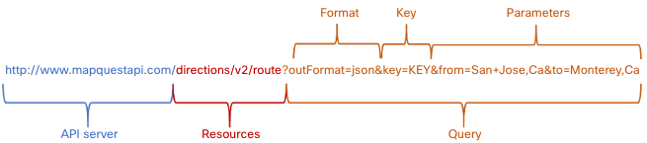
Software-Defined Networking Anatomy of a RESTful Request
In a RESTful Web service, a request made to a resource's URI will elicit a response. The response will be a payload typically formatted in JSON, but could be HTML, XML, or some other format. The figure shows the URI for the MapQuest directions API. The API request is for directions from San Jose, California to Monterey, California.
Notes:
14 - Network Automation
14.4 - REST
14.4.5 - Anatomy of a RESTful Request

Slide 29
Software-Defined Networking Anatomy of a RESTful Request (Cont.)
These are the different parts of the API request:
API Server - This is the URL for the server that answers REST requests. In this example it is the MapQuest API server.
Resources - Specifies the API that is being requested. In this example it is the MapQuest directions API.
Query - Specifies the data format and information the client is requesting from the API service. Queries can include:
Format – This is usually JSON but can be YAML or XML. In this example JSON is requested.
Key - The key is for authorization, if required. MapQuest requires a key for their directions API. In the above URI, you would need to replace “KEY” with a valid key to submit a valid request.
Parameters - Parameters are used to send information pertaining to the request. In this example, the query parameters include information about the directions that the API needs so it knows what directions to return: "from=San+Jose,Ca" and "to=Monterey,Ca".
Notes:
14 - Network Automation
14.4 - REST
14.4.5 - Anatomy of a RESTful Request (Cont.)

Slide 30
Software-Defined Networking Anatomy of a RESTful Request (Cont.)
Many RESTful APIs, including public APIs, require a key. The key is used to identify the source of the request. Here are some reasons why an API provider may require a key:
To authenticate the source to make sure they are authorized to use the API.
To limit the number of people using the API.
To limit the number of requests per user.
To better capture and track the data being requested by users.
To gather information on the people using the API.
Note: The MapQuest API does require a key. Search the internet for the URL to obtain a MapQuest key. Use the search parameters: developer.mapquest. You can also search the internet for the current URL that outlines the MapQuest privacy policy.
Notes:
14 - Network Automation
14.4 - REST
14.4.5 - Anatomy of a RESTful Request (Cont.)

Slide 31
Software-Defined Networking RESTful API Applications
Many web sites and applications use APIs to access information and provide service for their customers.
Some RESTful API requests can be made by typing in the URI from within a web browser. The MapQuest directions API is an example of this. A RESTful API request can also be made in other ways.
Developer Web Site: Developers often maintain web sites that include information about the API, parameter information, and usage examples. These sites may also allow the user to perform the API request within the developer web page by entering in the parameters and other information.
Postman: Postman is an application for testing and using REST APIs. It contains everything required for constructing and sending REST API requests, including entering query parameters and keys.
Python: APIs can also be called from within a Python program. This allows for possible automation, customization, and App integration of the API.
Network Operating Systems: Using protocols such as NETCONF (NET CONFiguration) and RESTCONF, network operating systems are beginning to provide an alternative method for configuration, monitoring, and management.
Notes:
14 - Network Automation
14.4 - REST
14.4.6 - RESTful API Applications
14.4.7 - Check Your Understanding - REST

Slide 32
14.5 Configuration Management Tools
Notes:
14 - Network Automation
14.5 - Configuration Management Tools

Slide 33
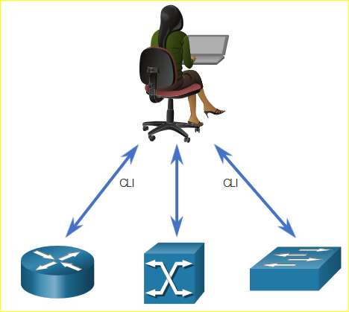
Configuration Management Tools Traditional Network Configuration
Network devices have traditionally been configured by a network administrator using the CLI. Whenever there is a change or new feature, the necessary configuration commands must be manually entered on all of the appropriate devices. This becomes a major issue on larger networks or with more complex configurations.
Notes:
14 - Network Automation
14.5 - Configuration Management Tools
14.5.2 - Traditional Network Configuration

Slide 34
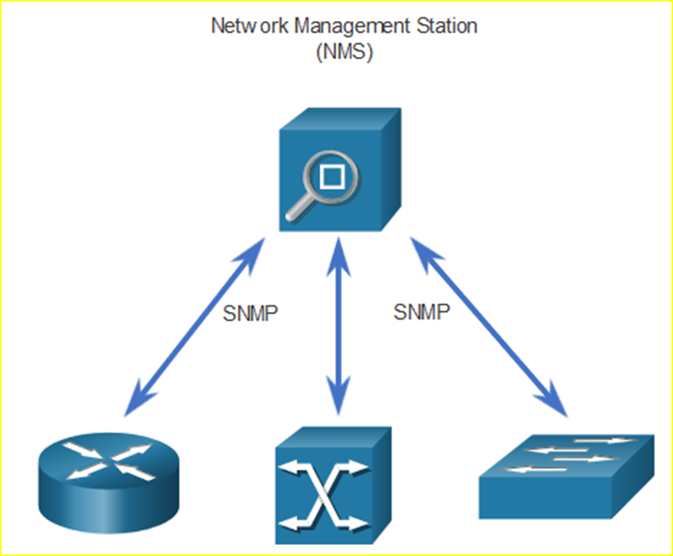
Configuration Management Tools Traditional Network Configuration
Simple Network Management Protocol (SNMP) lets administrators manage nodes on an IP network. With a network management station (NMS), network administrators use SNMP to monitor and manage network performance, find and solve network problems, and perform queries for statistics. SNMP is not typically used for configuration due to security concerns and difficulty in implementation.
You can also use APIs to automate the deployment and management of network resources. Instead of manually configuring ports, access lists, QoS, and load balancing policies, you can use tools to automate configurations.
Notes:
14 - Network Automation
14.5 - Configuration Management Tools
14.5.2 - Traditional Network Configuration

Slide 35
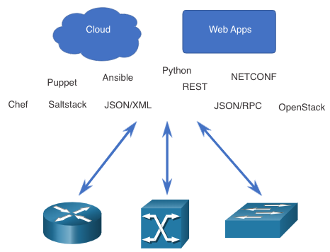
Configuration Management Tools Network Automation
We are rapidly moving away from a world where a network administrator manages a few dozen network devices, to one where they are deploying and managing a great number of complex network devices (both physical and virtual) with the help of software. This transformation is quickly spreading to all places in the network. There are new and different methods for network administrators to automatically monitor, manage, and configure the network. These include protocols and technologies such as REST, Ansible, Puppet, Chef, Python, JSON, XML, and more.
Notes:
14 - Network Automation
14.5 - Configuration Management Tools
14.5.3 - Network Automation

Slide 36
Configuration Management Tools Configuration Management Tools
Configuration management tools make use of RESTful API requests to automate tasks and can scale across thousands of devices. These are some characteristics of the network that administrators benefit from automating:
Software and version control
Device attributes such as names, addressing, and security
Protocol configurations
ACL configurations
Configuration management tools typically include automation and orchestration. Automation is when a tool automatically performs a task on a system. Orchestration is the arranging of the automated tasks that results in a coordinate process or workflow.
Notes:
14 - Network Automation
14.5 - Configuration Management Tools
14.5.4 - Configuration Management Tools

Slide 37

Configuration Management Tools Configuration Management Tools (Cont.)
There are several tools available to make configuration management easier:
Ansible
Chef
Puppet
SaltStack
The goal of all of these tools is to reduce the complexity and time involved in configuring and maintaining a large-scale network infrastructure with hundreds, even thousands of devices. These same tools can benefit smaller networks as well.
Notes:
14 - Network Automation
14.5 - Configuration Management Tools
14.5.4 - Configuration Management Tools (Cont.)

Slide 38
Configuration Management Tools Compare Ansible, Chef, Puppet, and SaltStack
Ansible, Chef, Puppet, and SaltStack all come with API documentation for configuring RESTful API requests. All of them support JSON and YAML as well as other data formats. The following table shows a summary of a comparison of major characteristics of Ansible, Puppet, Chef, and SaltStack configuration management tools.
Characteristic | Ansible | Chef | Puppet | SaltStack
What programming language? | Python + YAML | Ruby | Ruby | Python
Agent-based or agentless? | Agentless | Agent-based | Supports both | Supports both
How are devices managed? | Any device can be “controller” | Chef Master | Puppet Master | Salt Master
What is created by the tool? | Playbook | Cookbook | Manifest | Pillar
Notes:
14 - Network Automation
14.5 - Configuration Management Tools
14.5.5 - Compare Ansible, Chef, Puppet, and SaltStack
14.5.6 - Check Your Understanding - Configuration Management

Slide 39
14.6 Git
Notes:
14 - Network Automation
14.6 - IBN and Cisco DNA Center

Slide 40
How is this relevant to networking?
Programmability
Scripts
Even if you’re solo, version control is critical

Slide 41


Git vs. GitHub
Git is an open source distributed version control system / technology
GitHub is a commercial company, that runs GitHub.com based on Git VCS

Slide 42
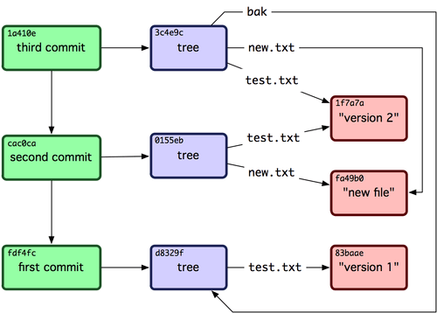
Under the hood
Changes are stored in trees
Trees contain changed files
Commits contain trees

Slide 43
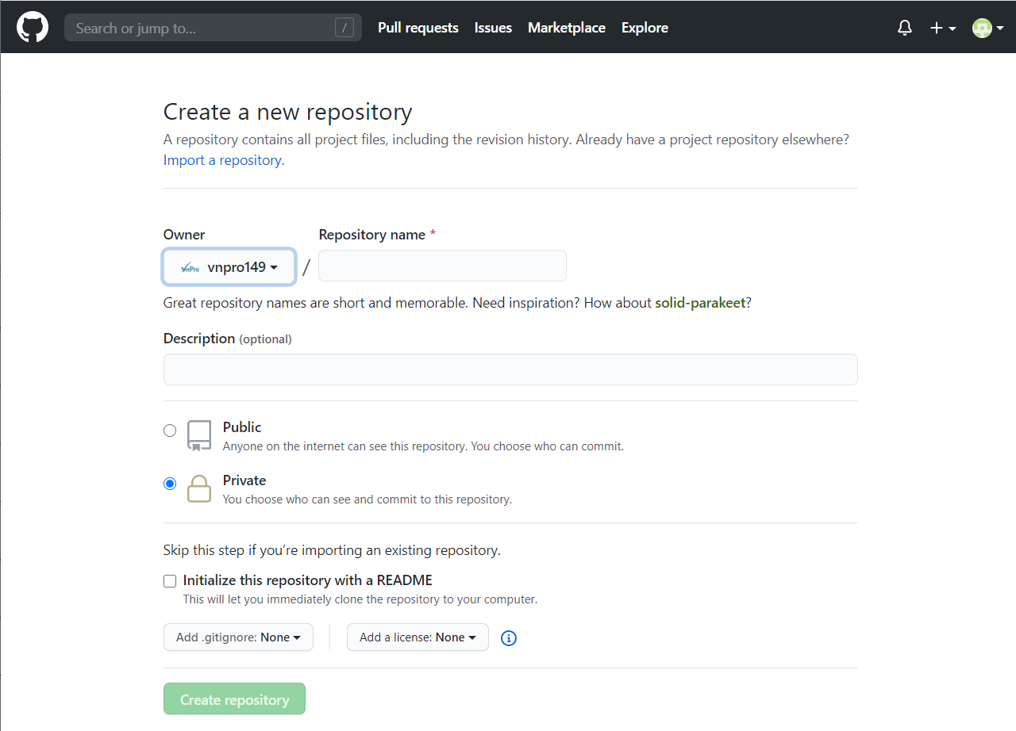
Getting Started with Git
Starting from GitHub (screenshot flow of new project)
Starting from your workstation (git init)

Slide 44
Getting Started with CLI: GIT CONFIG
So you can be held accountable, configure git
$ git config --global user.name "Your Name Comes Here"
$ git config --global user.email you@yourdomain.example.com

Slide 45
Getting Started: Cloning Projects
No password
Set up SSH key on remote server (e.g. ssh-keygen)
$ git clone git@github.com:aroach/upgraded-guacamole.git
$ git clone https://github.com/aroach/upgraded-guacamole.git

Slide 46
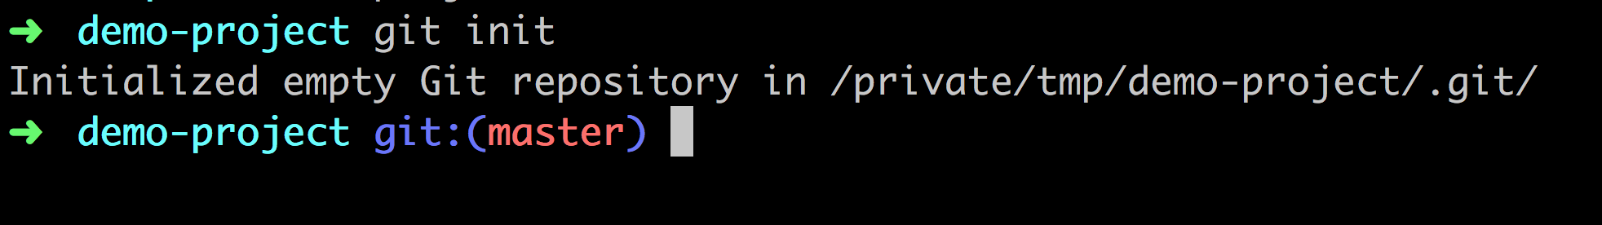
Getting Started: Local Repository

Slide 47
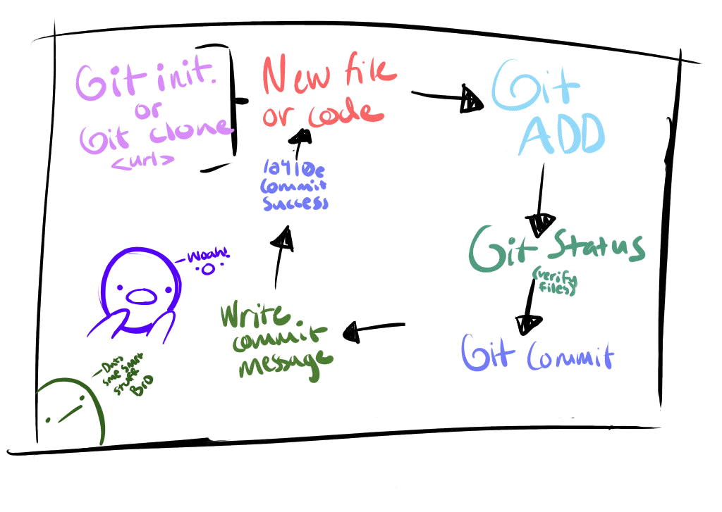

Slide 48
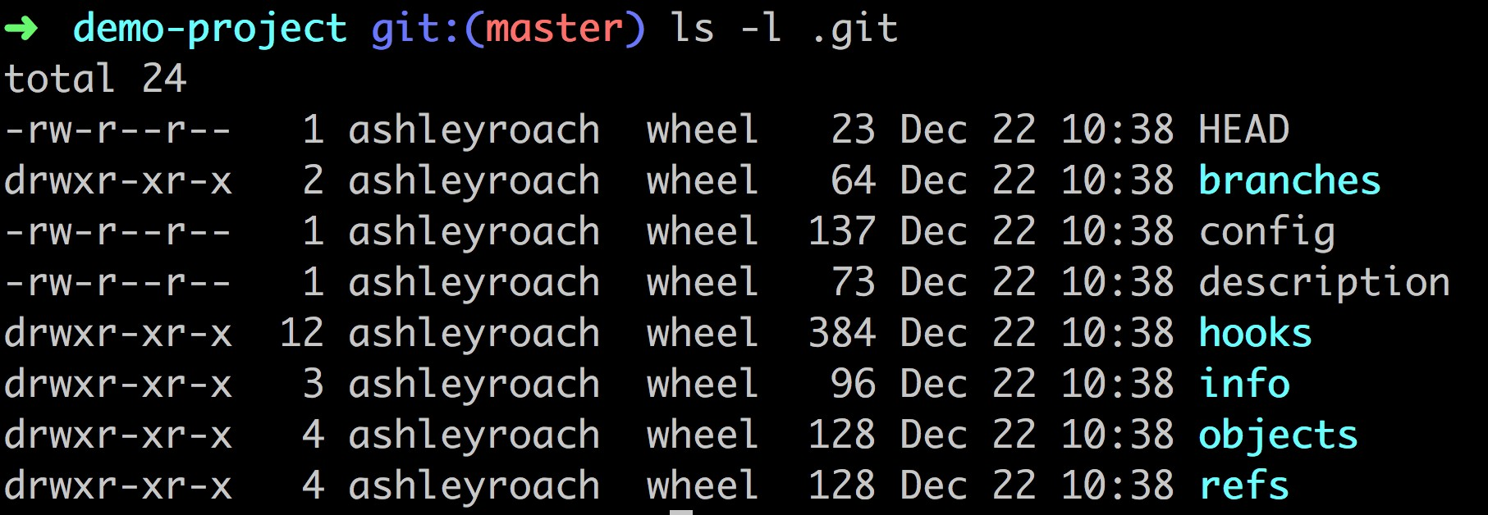
What’s inside .git?

Slide 49
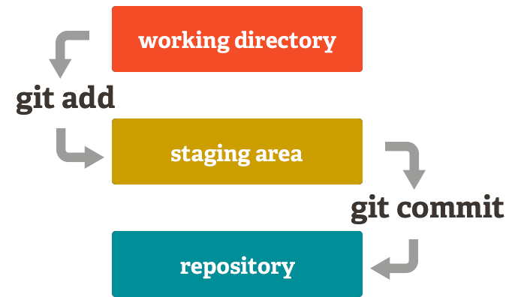
GIT ADD
Add any files in your repository to git “stage”
$ git add .

Slide 50
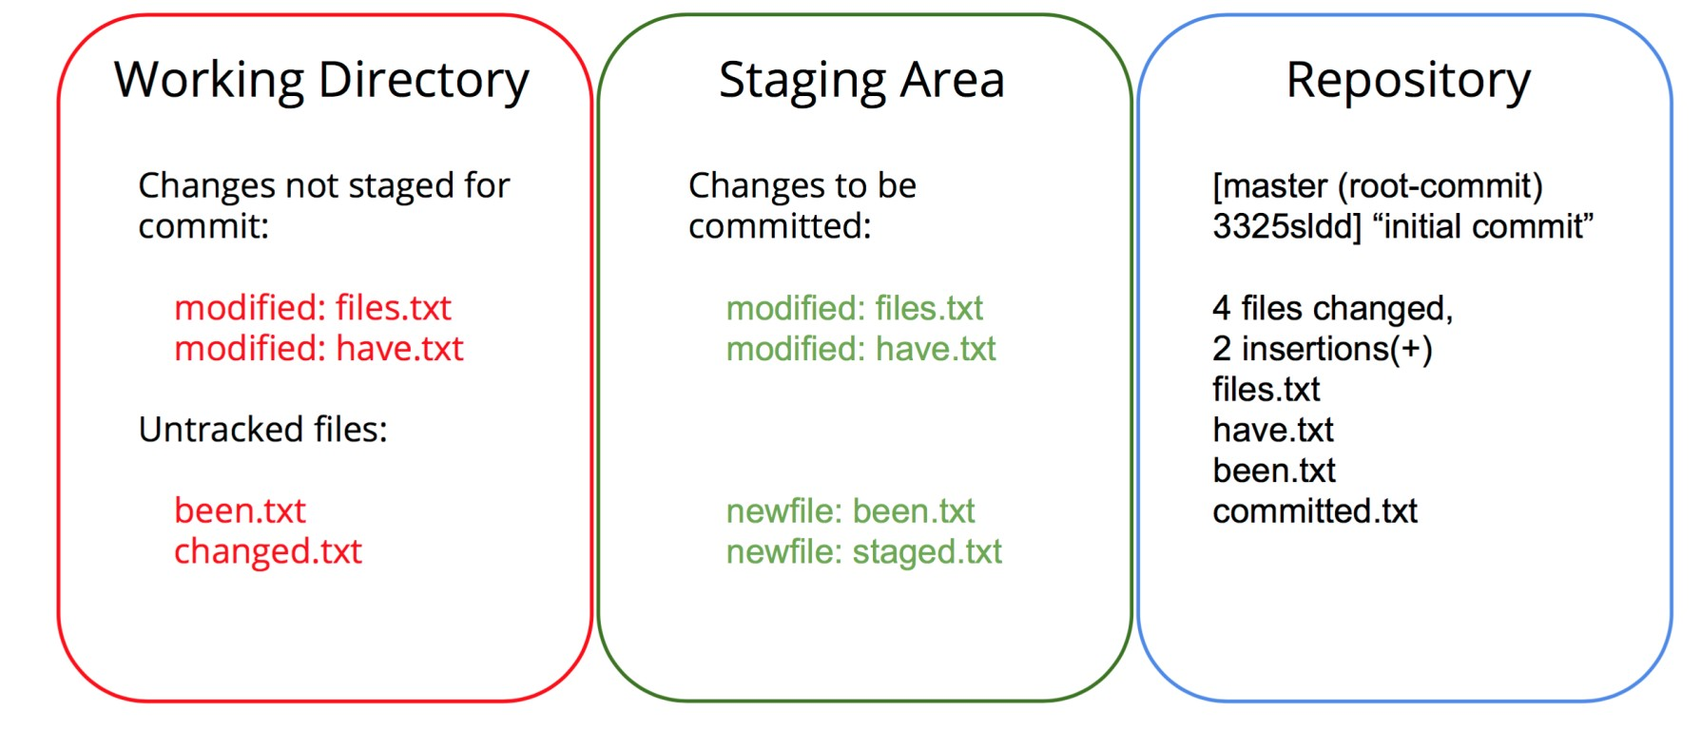
STAGING AREA

Slide 51
GIT COMMIT
Store your changes into a commit
Saves all of your changes together / save point
Commit does NOT push
$ git commit –m ’Initial commit’

Slide 52
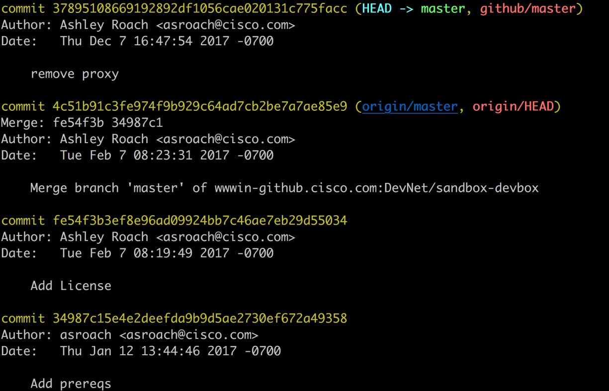
Git Log: History of commits

Slide 53
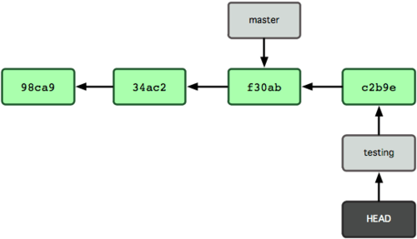
BRANCHING: Your safe place
Makes a pointer to your code
Moves HEAD around
$ git branch <name>
$ git branch testing
$ git commit –m “new”
$ git checkout master

Slide 54
MERGING
git merge <topic>
You must be on the branch you want to merge INTO when you execute this command (e.g. master)
$ git merge <branch>

Slide 55
GOING BACKWARDS
Generate a new commit that undoes all of the changes introduced in <commit>, then apply it to the current branch.
$ git revert <commit>

Slide 56
SHARE YOUR CHANGES
git push <destination> <branch>
git push origin master
$ git remote add <name> <url>
$ git push <name> <branch>
$ git push origin master

Slide 57
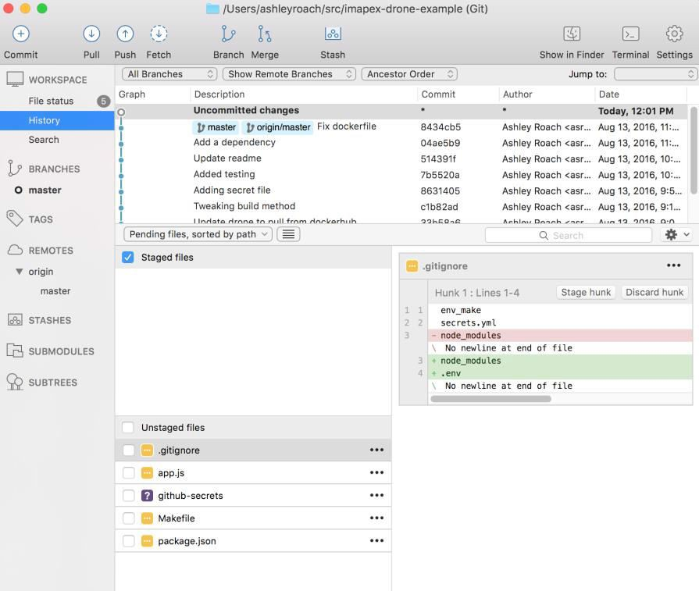
GIT CLIENTS
CLI Client
IDE Clients
VIM: airblade/vim-gitgutter
Emacs: magit
GUI Clients
SourceTree
Git Kracken

Slide 58
